Slide 1
CAI/AEC 2025
Programming
Solar Energy Control System
L. Daigle, M. Hutchinson, L. MacLennan, C. White
January 26, 2025

Slide 2


Meet the Team
Lauren Daigle
Project Manager
Matthew Hutchinson
Data Acquisition
and Debugging
Liam MacLennan
Networking Lead
Colby White
Mechatronics Lead

Slide 3
Background
In the face of climate change, deep decarbonization is necessary to satisfy increasing energy demands.
Solar and wind are low-cost solutions, however, wind is unpredictable
Solar is more reliable, and work can be done to optimize the energy output

Slide 4
Problem Statement
Participants must design a client-server application to monitor and control the operations of a solar power plant equipped with motorized photovoltaic panels and safety mechanisms. The system must include:
Data monitoring and storing
Control mechanisms
Wireless communication

Slide 5
Requirements
1. Data Monitoring and Storing
a. Collect data from sensors to calculate the power generated.
b. User interface - display the collected data.
2. Control Mechanisms
a. Adjust the angle of solar panels manually and automatically.
b. Emergency shutdown to remotely cut off the current flow to the grid.
3. Wireless Communication
a. Store and display data sent from client (ESP32) to server.
b. Errors – server must manage and reconnect.

Slide 6
Constraints
1. Hardware
Only the assigned hardware can be used (ESP32 for sensor and Raspberry Pi for server) and cannot be modified.
2. System Network
The system must be wireless and communicate through Wi-Fi. The network must be a hotspot hosted by a computer.

Slide 7
Specific Objectives
1 | Read and Display Data
-Voltage, Current, Angle
2 | Interface Hardware
-Manually adjust panel angle with an interface
-Fault checking (button)
-Fault LED
3 | Automation
-Shut off servo upon a fault and re-enable once resolved.
-Automatically track the sun angle

Slide 8
Specific Objectives cntd.
4 | Wireless Data Acquisition
-Wirelessly communicate with Pi Server
-Notify on disconnect, attempt to resolve and reconnect
5 | Web Based Interface
-Website interface
-Graph real-time data (no refreshing)
-Interface scales to mobile devices and desktop

Slide 9
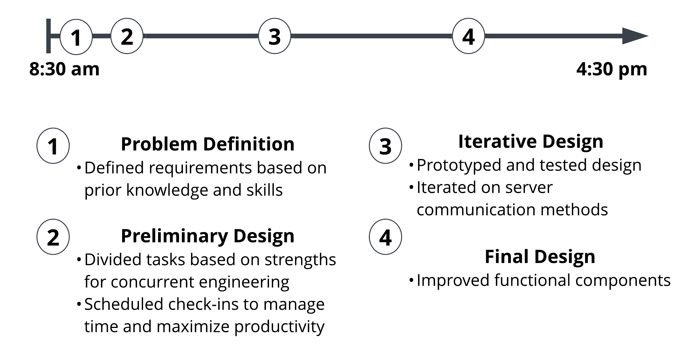
Design Process

Slide 10
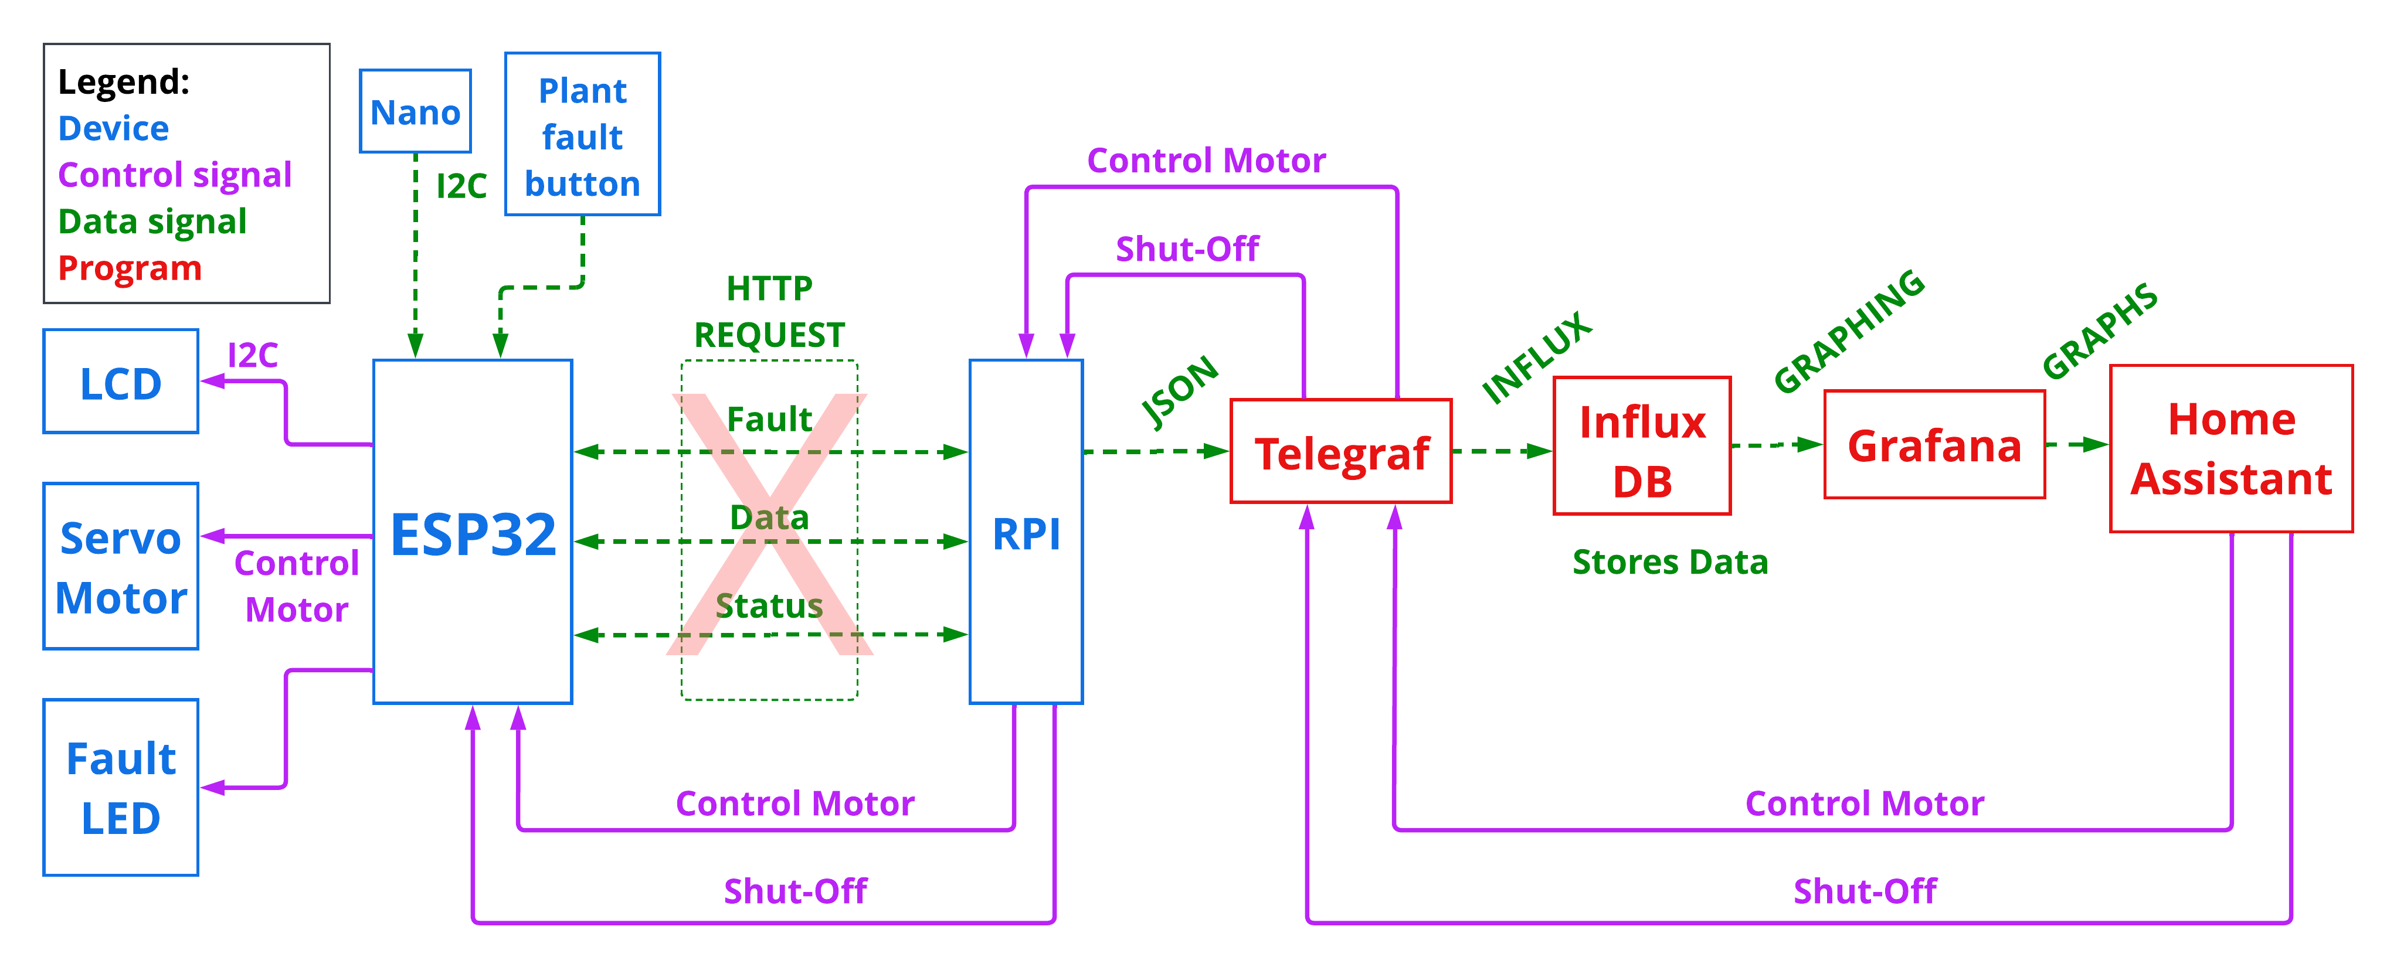
Solution

Slide 11
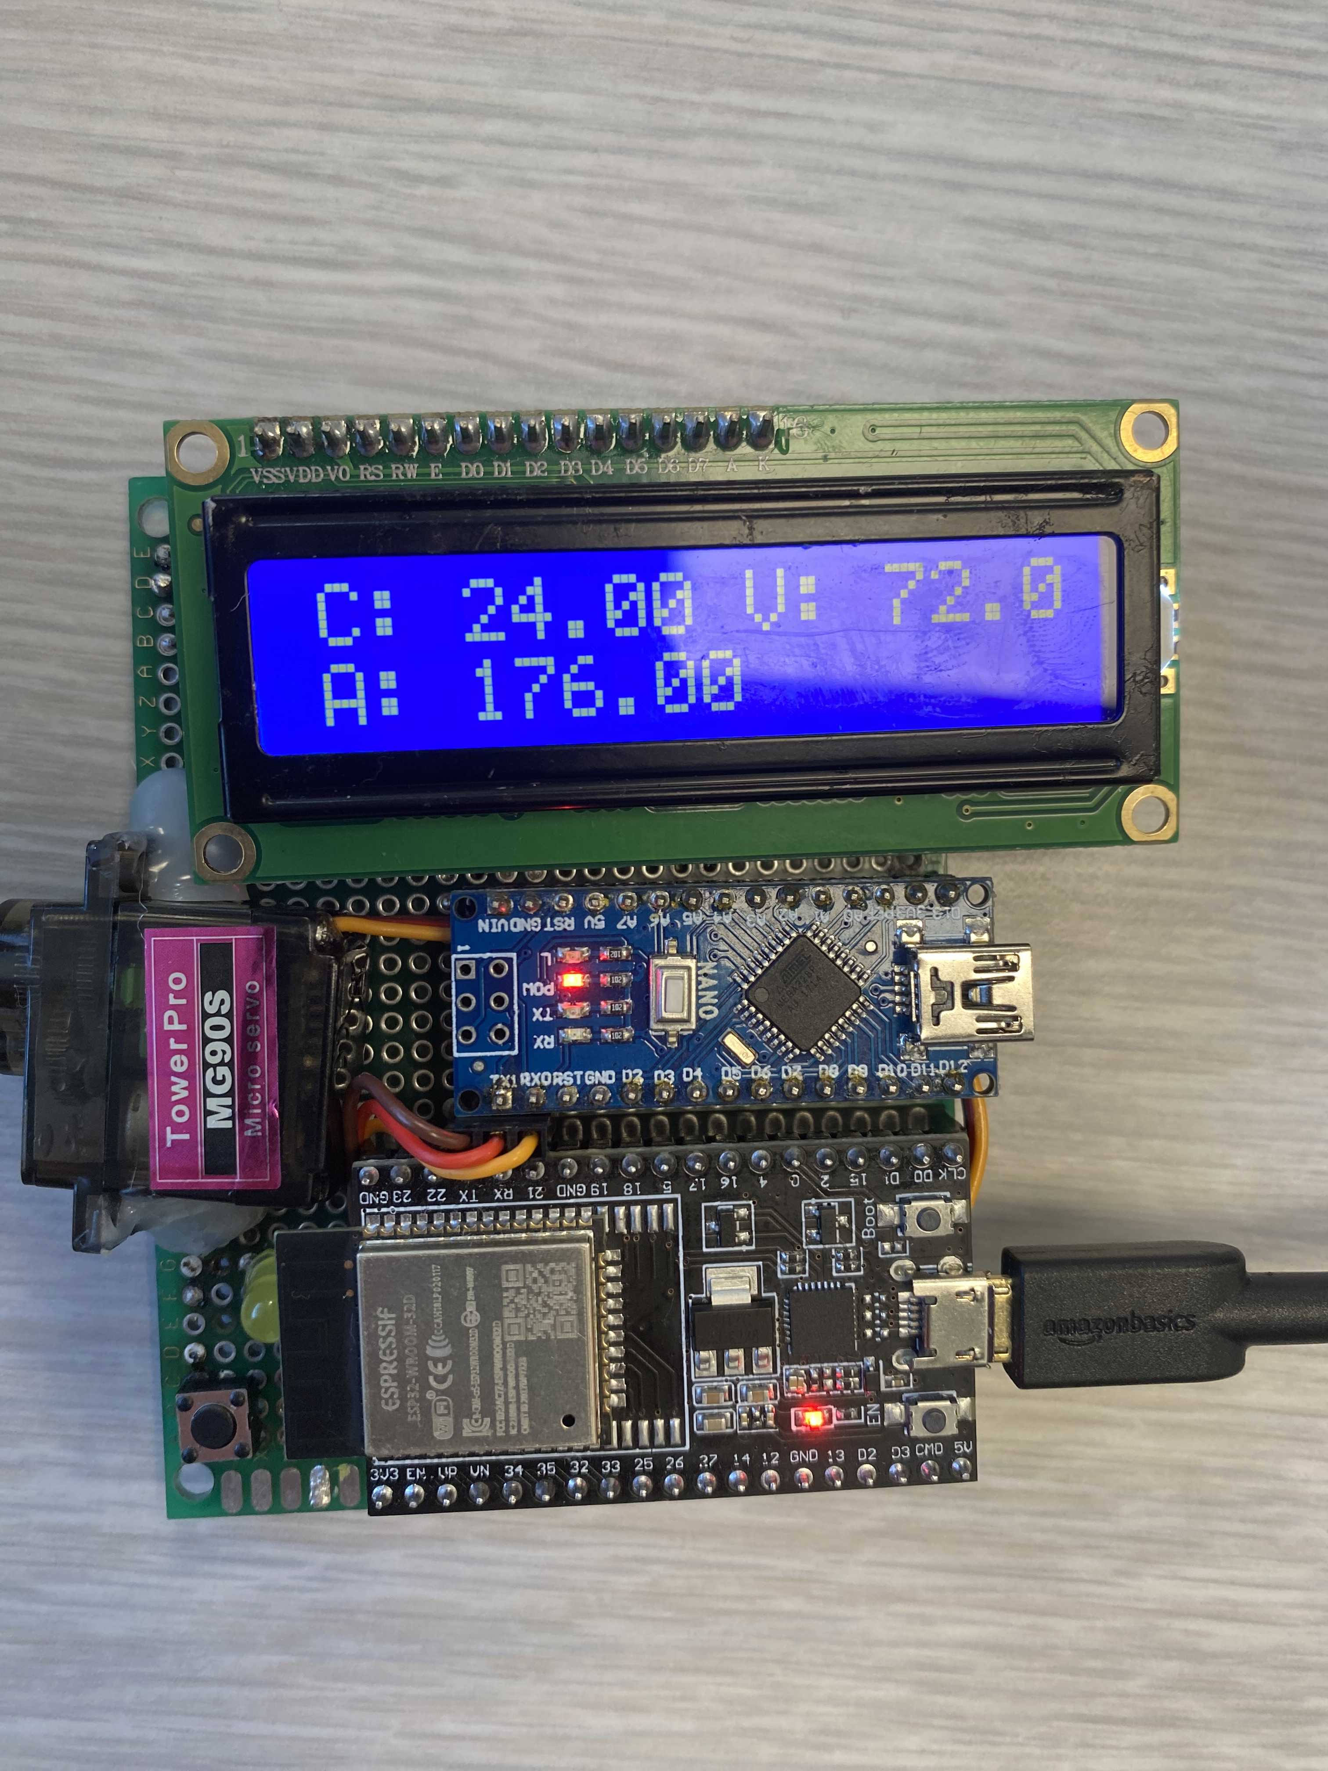
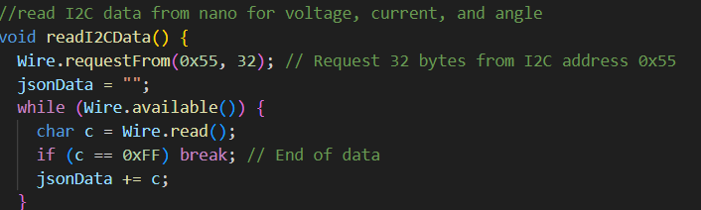
S. Objective 1
1 | Read and Display Data
-Voltage, Current, Angle
Utilized the LiquidCrystal I2C library by Frank de Barbander [1]
And the Wire library by Expressif Systems [4]
-Previous experience
-Confidence in a successful outcome

Slide 12
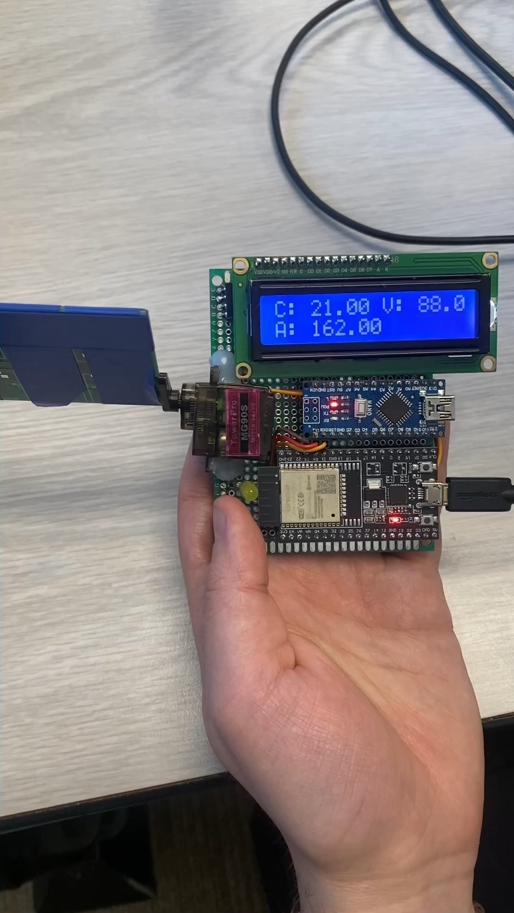
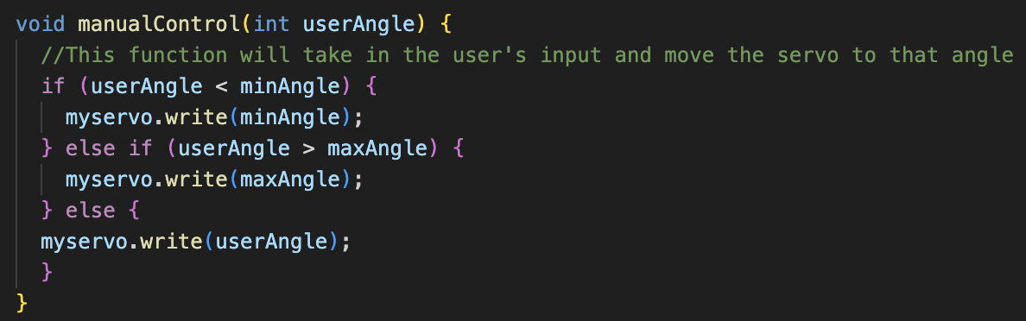
S. Objective 2
2 | Interface Hardware
-Manually adjust panel angle with an interface
-Fault checking (button)
-Fault LED
Used ESP32Servo library from Kevin Harrington and John K. Bennett [2]
Notes:
Talk about how it could manually adjust, except the interface doesn’t work

Slide 13
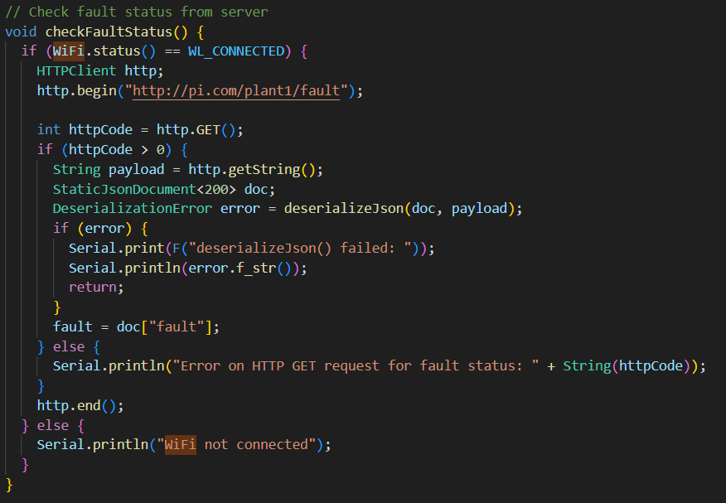
S. Objective 3
3 | Automation
-Shut off servo upon a fault and re-enable once resolved.
-Automatically track the sun angle
Notes:
Same servo code is used however using the I2C angle data in the argument

Slide 14
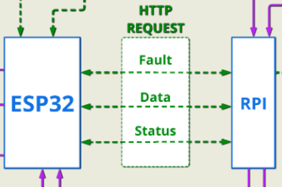
S. Objective 4
4 | Wireless Data Acquisition
-Wirelessly communicate with Pi Server
-Notify on disconnect, attempt to resolve and reconnect
Originally focused on MQTT communication due to its flexibility in IOT applications.
Moved to HTTP/S upon discovery of Raspberry Pi Backend Issues
Unable to resolve connection issues

Slide 15
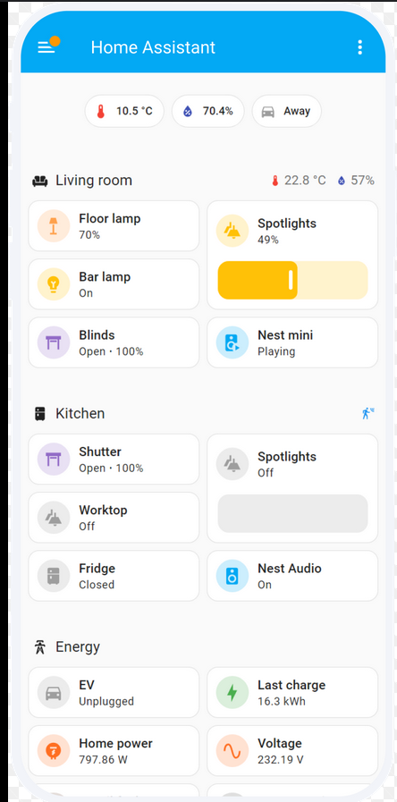
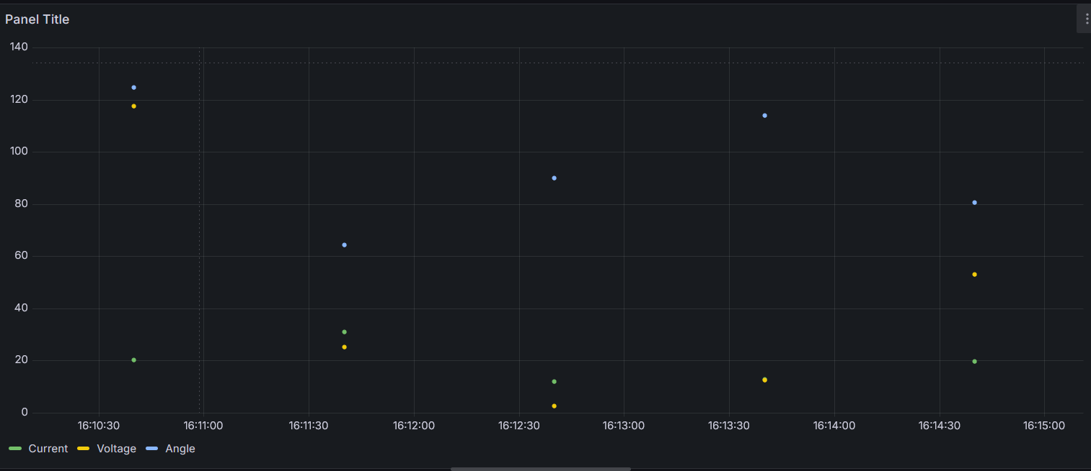
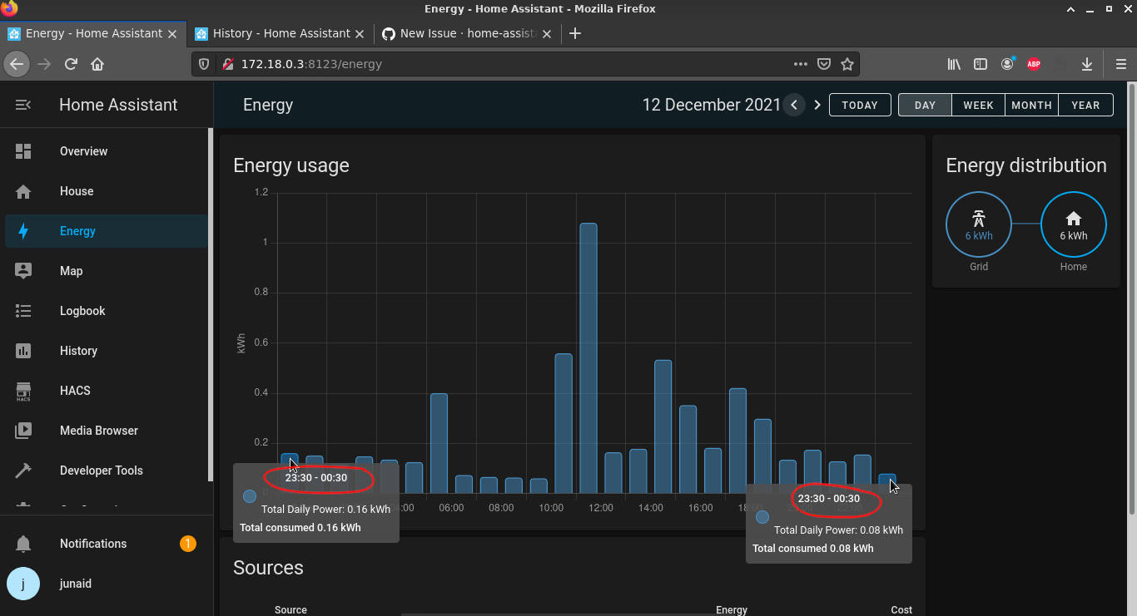
S. Objective 5
5 | Web Based Interface
-Website interface
-Graph real-time data (no refreshing)
-Interface scales to mobile devices and desktop
Home Assistant
Scales to either web clients or mobile devices
Allows for real-time visualization of graphed data
Allows for an all-in-one platform for data visualization and monitoring

Slide 16
Testing
Tried out the data reading, LCD display, and motor control. Minor adjustments to limits corrected their functionality
Attempted multiple connection strategies, encountering persistent errors throughout. Explored various methods to successfully broadcast the data, but challenges persisted.
Generated random test data for database validation and visualization within the platform

Slide 17
Errors and Critiques
Server side (Raspberry Pi):
Unable to resolve peer connection refusal by telegraf
Unable to implement front end graphing of real-time data
Unable to implement front-end fault reset and manual override from front end.

Slide 18
Solar Energy Control System
L. Daigle, M. Hutchinson, L. MacLennan, C. White

Slide 19
References
[1] LiquidCrystal_I2C: https://github.com/johnrickman/LiquidCrystal_I2C (Author: johnrickman)
[2] ESP32Servo: https://github.com/madhephaestus/ESP32Servo (Author: madhephaestus)
[3] ArduinoJson: https://github.com/bblanchon/ArduinoJson (Author: Benoît Blanchon)
[4] Wire: https://github.com/espressif/arduino-esp32/tree/master/libraries/Wire (Author: Espressif Systems)
[5] WiFi: https://github.com/espressif/arduino-esp32/tree/master/libraries/WiFi (Author: Espressif Systems)
[6] HTTPClient: https://github.com/espressif/arduino-esp32/tree/master/libraries/HTTPClient (Author: Espressif Systems)
[7] WiFiClientSecure: https://github.com/espressif/arduino-esp32/tree/master/libraries/WiFiClientSecure (Author: Espressif Systems)
[8] GitHub Copilot: Used for autocompletion assistance

